Slide 1
Getting Started with MVVM
Download slides and project at http://utahcodecamp.com/downloads
By Brent Bulla
Utah Code Camp March 2012

Slide 2
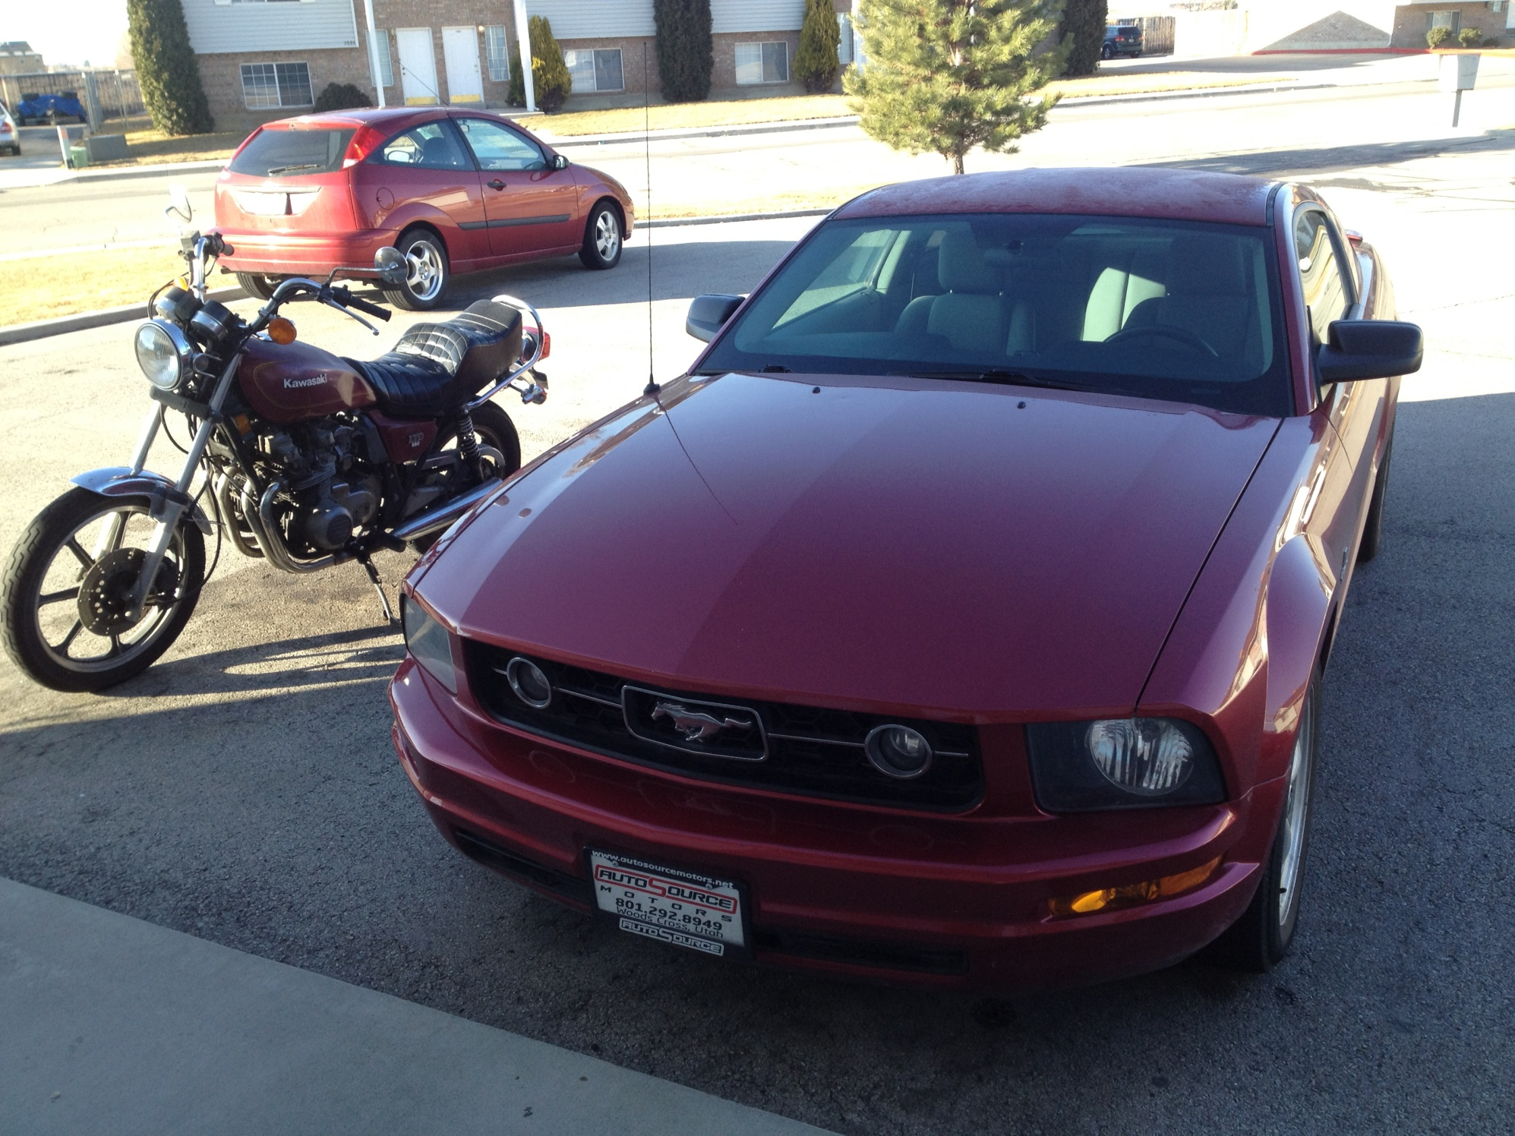
About Me…
MVVM crazy
Software Architecture purist
Not just a coder…(tester, hardware engineer, too)
Since my presentation at Utah Code Camp, I’ve added the View Injector and Mediator since then…so this is even better!

Slide 3
Assumptions
You all know WPF and/or Silverlight…already
  If not, learn that by itself first! Then come back to MVVM
  I’ll briefly show some XAML but won’t have time to dig into it
Are already familiar with C# & .NET 4.0 (lambdas, TPL, thread safe collections, etc…especially lambdas b/c I use the heck out of them)
  Purpose
Give examples and explain how to implement MVVM as a pattern, w/o any other frameworks or helpers to aid you.
  If you want to add 3rd party tools to your own projects, be my guest (and this is a good idea, btw), but make absolutely certain you understand your 3rd party helpers!
    If not…the bug fairy will most likely visit you much more often

Slide 4
Why do you care?
You are driven to bolster your resume and want to understand the latest software tech buzzwords for interviews.
You have been told to ‘figure it out’ by your manager and then ‘Put it in the product. I hear it’s great.’
You really, truly, deeply care about moldable, reusable, agile, loosely-couple software architecture. This is what drives you to work 60 hour weeks.

Slide 5
Why should you care?
Less bugs
More robust code
  This means that you write a little more that takes a little longer up front, so that you can write a lot less with much fewer bugs later
Reduces stress
  Stress levels in software engineering can be tied to many things; one of which is how much related code you must understand before you can feel comfortable fixing or enhancing any specific chunk of code
  MVVM reduces software into loosely coupled chunks, naturally – like putting on a warm blanket as the wind howls outside.
Utilizes the technology as it is intended (WPF and Silverlight)
Allows concurrent work to occur more cleanly, in any and every layer (software chunkability…no that’s not a word)
Allows a code reuse factor that is otherwise unobtainable
MVVM/MVC are the new development patterns – used on Android, iOS, and Windows Phone 7, not to mention WPF and Silverlight (so get used to it!)

Slide 6
MVVM…more than a buzzword
It’s like MVC…
It’s like MVP…
But what is it??

Slide 7
What is it?
A software architecture pattern, discussed here 7 years ago, but still applicable
Designed by Microsoft and used by them internally while developing WPF
The pattern means “Model-View-ViewModel”,
…but we’re going to reverse that order and talk about the View (and View Injection), then the ViewModel (and the Mediator), then the Model (and Services)

Slide 8
The View (not the TV show)
Responsible for what the end user interacts with
Has no knowledge of how to get back end data
Has a shallow knowledge of its DataContext only so that it represents the required functionality correctly
Ideally, never needs to interact with the ViewModel directly, nor any Model
In summary,
  The UI only cares about UI.
  The UI only knows about UI.
  The UI does not need a DataContext to function

Slide 9

Example View Binding to a DataContext

Slide 10
View Injection
Rationale: Ideally, views know very, very little about each other…maybe just by name only (interface moniker or something)
The concept of View Injection is that a ViewInjector:
  Can set content on ContentControl(s) or similar in a Shell (empty Window control) through Binding(s)
  Reacts to navigation requests from other sources and sets the content(s) on demand
This is accomplished by having a ShellView (a Window) with a ContentControl (and not much if anything else)
  The ViewInjector then latches onto the ContentControl (by attached properties or in the Shell’s ViewModel) and sets its content based on requests
  The content is an instance of another View

Slide 11
Demo View Injector

Slide 12
ViewModel
Shuffles data requests to and from the View and the Model(s) through Services
Is the DataContext for a View and the container for all required business logic
Acts as the ‘glue’ that holds the pattern together
  That is, it loosely links the View to the Model(s)
You have a really good ViewModel when the following criteria are met:
  It is 100% unit testable
  It is never on the UI thread (explicitly)
  It has no idea how to get the data it uses and passes to the View
  It doesn’t need a View to work correctly
  It implements INotifyPropertyChanged
    This is what makes the binding work between the View and ViewModel

Slide 13
Mediator
Acts as a messaging service
  In Prism, this is the IEventAggregator implementation
  In MEFedMVVM it is the Mediator (which is shorter to type)
Can be used in a generic fashion across the entire product (I do this) or used to just communicate between viewmodels
  Shouldn’t matter how it’s used…just why
It’s only purpose is to decouple classes
Example:
  ViewModel A fires an event somewhere in the system
  Class B in a far away dll reacts to the event and starts cooking dinner
  ViewModel C in a still farther away dll reacts to the event and updates a prop
  Without a Mediator or something similar, Class B and ViewModel C would have to directly reference the instance of Class A and subscribe to Class A’s event – bad design (tight coupling and unnecessary code)!

Slide 14
Demo a View Model and a Mediator

Slide 15
Model
Represents data from the back end (whatever back end you have – database, flat files, in memory storage, isolated storage, etc.)
Never needs the UI thread!
Is ‘managed’ by Data Services (more on that in a sec…)
Can develop the qualities of a ViewModel at any time…as it makes sense
  If this is logic specific to the Model that the Model should own, then by all means, put it in the Model
  This includes having a reference to a data service to retrieve sub-Models (think a Library model that has many Book models)
  Views should bind as pragmatically as possible
    Do not create wrapper properties around Model properties in a ViewModel
    Just have the Model be smart enough to fire PropertyChanged events, and bind directly to them!
      E.g. Author.Name instead of something like AuthorName (which is pulled from Author.Name)

Slide 16
Data Services
Manages the Model
  Communicates with the back end to get and send data and present them as Model(s) to the consumer (ViewModel(s) or something else)
Architecture Bonus: Can obfuscate or decouple the actual objects in the back end from the Model(s) presented to the View by giving the ViewModel custom objects (allows for swapping out back ends easily)
Never needs the UI thread!
Has no idea how it’s data is presented or used
Can handle it’s own updates
Architecture Bonus: Can also implement INotifyPropertyChanged to fire events when its properties are updated
  Why can this be a good idea?

Slide 17
Other Services
These are all made up by me (and others):
UiDispatcherService
MessageBoxService
ViewStatusAwareService
ViewModelLocatorService
ViewLocatorService
GetMeSomeCaffeineService (not yet implemented)

Slide 18
Demo a service…and a model or two

Slide 19
Sound good?
Does the pattern make sense?
Do you like the benefits? Such as,
  Loose coupling of classes
  Abstraction of layers
  100% unit testability…on any layer
Would it be a valuable pattern to learn and implement?
  Hopefully, this is rhetorical ☺

Slide 20
Gotcha(s)!
Bindings between the Views and ViewModels should only be done through Public Properties in the ViewModel
  You could probably use a Field, but I’ve never tried it and neither should you (fields should always be private anyways…)
  Means…you can’t bind to methods (but what about button clicks??)
Any propery set in the ViewModel that is/can be bound to the view (i.e. any public property) must be set on the UI thread or you will get cross-thread exceptions
  Wait a minute…I thought you said the ViewModel should never know when to jump on the UI thread?
The DataContext must be set to the ViewModel…at some point.
  So how are these decoupled again?
What about MessageBox’s?? User interaction that affects state in the ViewModel??
  We already covered this actually, but in case you forgot…Services!

Slide 21
Hurdles whilst learning MVVM
Must (continue to) learn to think abstractly – take it to a whole new level.
Become a master at patterns/ideas such as:
  SoC – separation of concerns
  Loose coupling
  IoC – Inversion of Control (this really boils down to dependency injection)
    Instead of going ‘out’ and finding what your viewmodel needs to work, demand that it is supplied to you on inilization
    Related (or equal?) to the Dependency Inversion Principle (from Wikipedia, so it must be true):
    High-level modules should not depend on low-level modules. Both should depend on abstractions.
    Abstractions should not depend upon details. Details should depend upon abstractions.
  Open Close Principle – ok to enhance a class, but architect and design methods to be written once
Quit doing what is easy to write the first time, but difficult to maintain/refactor/enhance
Develop a desire to generalize your code architecture – always and forever
Development using MVVM will take longer (at first) than doing it without
  Once you’re fully ramped up, it will take about the same amount of time to create, and less time to manage, debug, enhance and reuse

Slide 22
Example demo in all its glory

Slide 23
Summary
Use MVVM to bring a new level of peace into your programming lifestyle
Do not use MVVM unless you really want to use an effective software architecture, in a product that will grow over time
  What professional products will not grow over time and who doesn’t want more peace??
Use MVVM as it makes sense for your applications needs
  There are no MVVM police to dock your software when you break the pattern
  But don’t make a habit of breaking the pattern because the pattern works more often than it doesn’t!
If you are a Winform programmer, I would recommend never breaking the pattern b/c that just invites the addiction back into your life of tightly coupling the UI with the business logic
…maybe after a year of solid abstinence…
When learning MVVM, it is important focus on the “Shu” of “Shu Ha Ri”
  Do it the prescribed way even if you don’t understand why
  After a while, you will see for yourself the benefits of doing it

Slide 24
MVVM Resources/Frameworks
Prism – not an MVVM framework, but a fantastic aid in decoupling your layers and product components
  Provides an event aggregator, region manager (for view injection) and IoC
Caliburn
  Prefers convention over explicit code (a lot of the inner workings appear to be ‘magical’)
MEFedMVVM
  Provides a XAML based ViewModel injector, a Mediator, IVisualtStateManager and a bunch of other goodies
Cinch
  Provides a lot of very useful services and a decent ViewModel base right out of the box
  Relies on MEF and uses MEFedMVVM, as well
MVVM Light Toolkit
  Also provides an event aggregator for communication between modules and viewmodels
Go here for a detailed list…or make your own framework like I did for this demo!
Jeremy Likeness has an excellent series on how to use MEF instead of Prism
A guy on CodeProject who already did this tutorial…with much more detail (but with his own code)!
  But I dare say my MVVM implementation is better…oh yes, I dare say it.

